Slide 1
Module 2
Blockchain Primitives

Slide 2
Hash Functions
Any kind of input (of arbitrary length)
Output a string of characters of fixed length
Deterministic
Fast to compute
Infeasible to reverse
2 similar inputs should give very different outputs
Collision resistant (no 2 input with the same output)
Examples of existing use cases
Checksum
Password hashing
PoW
Data verification
PRNG

Slide 3
Public key cryptography (asymmetric)
A seed -> key generator -> key pair
2 main features of asymmetric key cryptography:
Encryption
Public key to encrypt msg
Private key to decrypt
2. Authentication can be done by using public key to verify that someone owns the corresponding private key (signing)
How does signing work?
Verifiers take original doc and hash
Verifiers take signed doc and decrypt with public key
Compare the hash document of 1 and 2

Slide 4
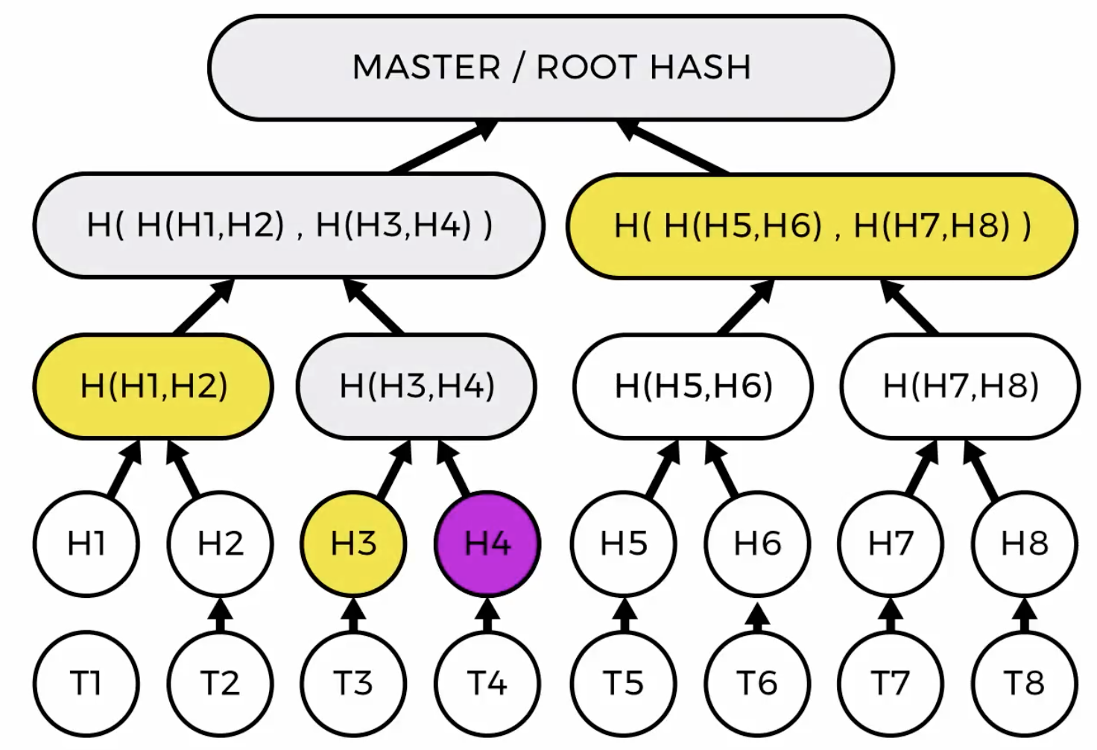
Merkle trees
Types of nodes
Leaf nodes represent the cryptographic hash of data
Non leaf nodes represent the cryptographic hash of the hashes of the child nodes
Can effectively verify all contents using the root
Traversing the tree only takes O(log n)
Only need a subset of data to do verification

Slide 5
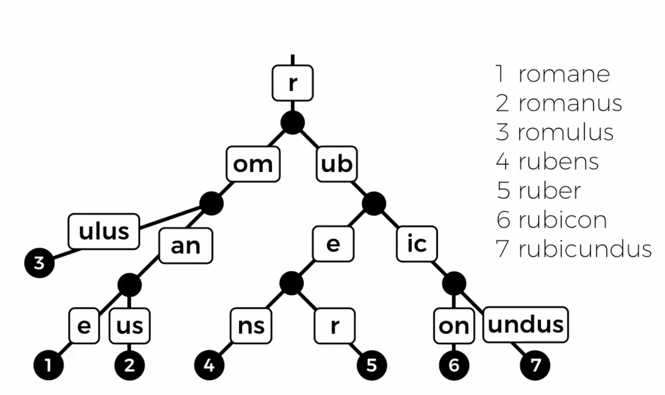
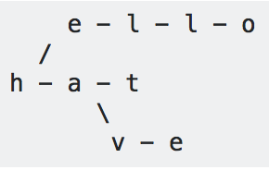
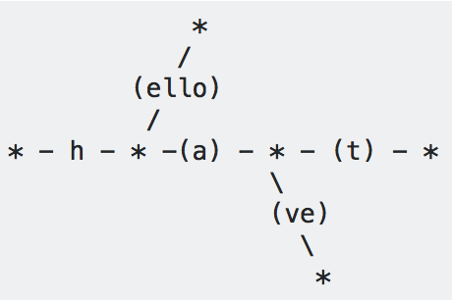
Patricia trees
Space optimised radix trees
Stores key value pairs
Easily searchable and efficient insertion and deletions
Ethereum uses a combination of both trees
Trie vs patricia tree
hello, hat, have

Slide 6
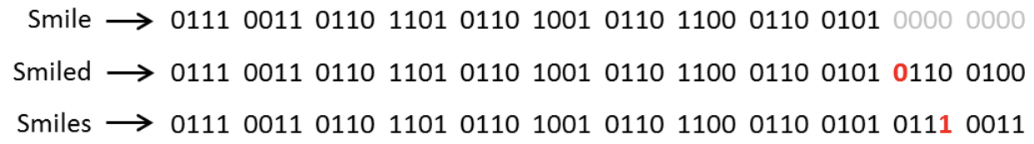
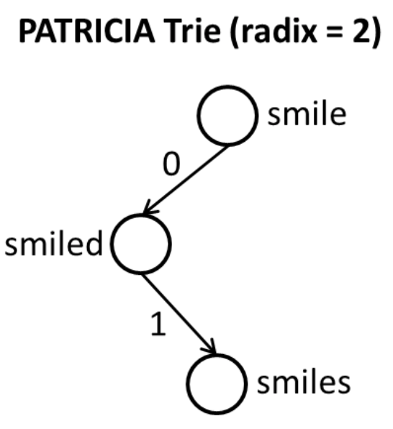
Patricia vs radix trees
Radix = number of child
Patricia is a radix tree with a radix of 2
Keys are treated as a stream of bits
Keys are compared r bits at a time
where 2^r = radix of the tree
Patricia therefore compares 1 bit (hence 2 child) at a time
If bit = 0, left and bit = 1, right.

Slide 7
Blockchain structure
Maintain a state everyone agrees on
Can be managed by participants in the network
Agreement on the updates therefore agreement on the latest state
Time stamp
Blocks (represented by merle tree root hash)
A group of txn
A hash of prep block
A nonce (modified by miners to find a block hash that is below a target value)
Once constructed, the block is broadcasted
Work begins on the next block
Created blocks are immutable (because of the prev hash)
In Ethereum, block headers contain 3 merkle trees
Txn data
Receipts (showing the effects of the txns)
State

Slide 8
Smart contracts
A digital protocol that digitally executes the terms of a contract
Features:
Trustless (no intermediary and universally accessible)
Trackable and auditable
Irreversible
Self executing
Node = Gateway to network
Past / current: server based -> slow and single point of failure
Blockchain: peer 2 peer -> fast and no single point of failure
Light client verifies small part of the blockchain
Full node does the following:
Downloads the full copy of the blockchain
Verify correct block reward distribution
Verify that txn have correct signatures
Verify that txn and block in correct data format
Ensure no double spending
Mining node = full node + ability to write to chain

Slide 9
What are forks?
When a chain splits into 2 (regardless of whether it was intentional or through PoW competition)
Hard fork vs soft fork
Hard forks are:
Not backwards compatible
Nodes of new chain will reject blocks from nodes of old chain
Soft forks are:
Compatible with old chain
A smaller subset of rules from old chain (more strict)
If 51% of the network adopts the new rules, old rules will no longer be used.
Unintentional forks
when 2 blocks are found at the same time
Longest chain is the valid chain
6 block confirmation after your block to more or less ensure that your block is confirmed.

